Slide 1
Instant and Inclusive Payment System for Cabo Verde (Pilot)
April 14, 2025

Slide 2
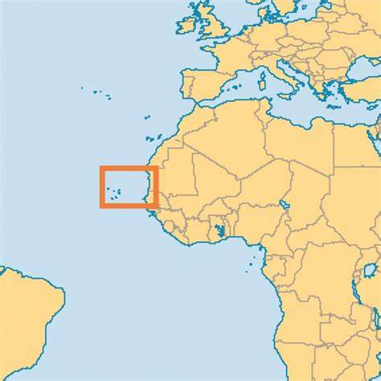
Payment Ecosystem in Cabo Verde
Area: 4,030 sq. km (Coastline: 965 km)
Population: 522,331 (2023)
Payment Ecosystem:
7 banks and 15 licensed MFIs
~400,000 bank account holders
~350,000 banks cards in circulation
~700,000 bank accounts
218 ATMs and 11,948 POS terminals
53 million transactions processed in 2023 for a cumulative amount of 187 Billion escudos
(1.848 billion USD)
Strong digital banking and card transaction penetration compared to other African countries.
SISP is the switch operator owned 40% by BCV and 60% by the commercial banks.

Slide 3
Pilot Objectives
Demonstrate Person-to-Person payments between selected Financial Service Providers (FSPs)
Demonstrate how Mojaloop can serve an inclusive national payment system by involving all Financial Service Providers
Provide local integrators with hands-on experience with Mojaloop
Gather adequate knowledge to build a project plan and cost model for a national payments system that includes all Financial Service Providers
Successful demonstration of end-to-end P2P by using/ connecting test environments of Financial Service Providers
Facilitate settlement through a simulated process, where reports are manually generated and provided to the Bank of Cabo Verde for executing the settlement transfer

Slide 4
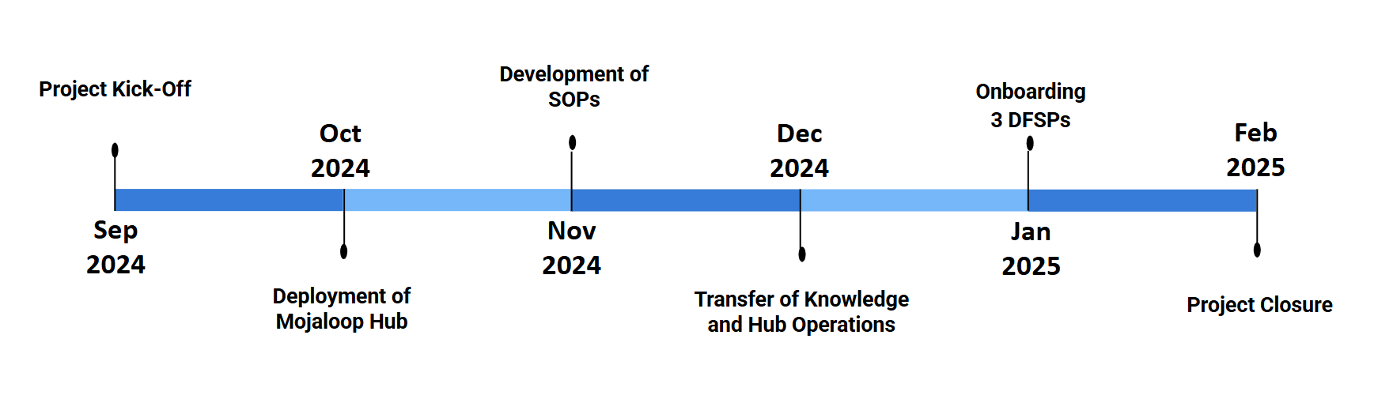
Key Activities & Timeline
The Cabo Verde pilot project was successfully delivered in just 100 working days—from kick-off to end-to-end demonstration—with 3 DFSPs seamlessly connecting their back-end systems to the Mojaloop Hub. This achievement sets a gold standard and serves as a benchmark for future projects, showcasing efficient execution and optimal resource allocation.

Slide 5
Governance Structure
Project Steering Committee
Project Management Team
Technology Workstream
Business Workstream
Regulatory
Workstream
Hub Operations Workstream
Charged with payment system's design, implementation and testing.
Responsible for exploring business requirements and strategies for implementation and market adoption.
Focused on laying the foundation for regulatory compliance and developing a scheme rulebook draft.
Responsible for managing onboarding processes, operational guidelines, and settlement procedures.

Slide 6

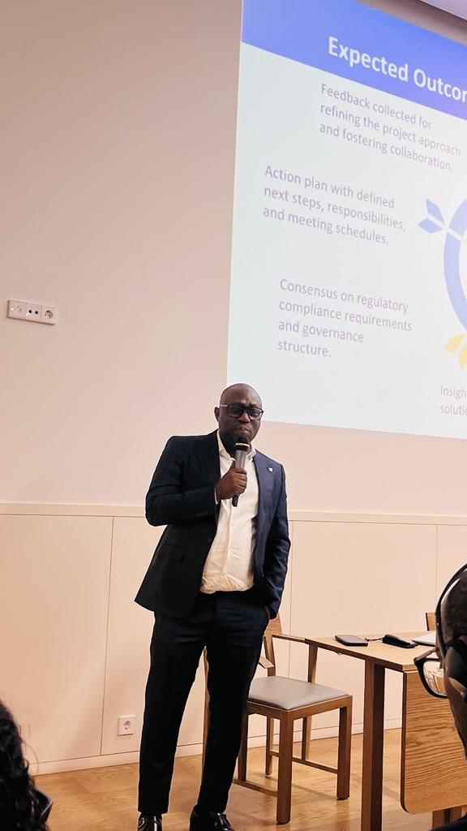
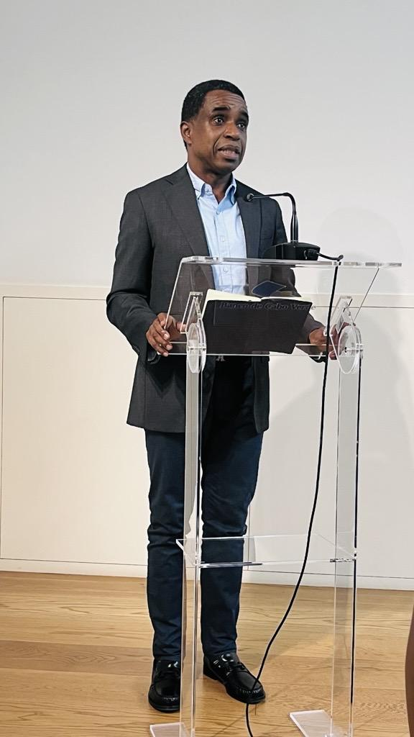
Governance Structure
Project Lead: Banco de Cabo Verde (BCV)
Participating DFSPs:
(1) Banco Caboverdiano de Negócios (BCN),
(2) Banco Comercial do Atlântico (BCA),
(3) Caixa Económica de Cabo Verde (CECV),
(4) Ecobank Cabo Verde (ECV)
Systems Integrator: Sociedade Interbancária e Sistemas de Pagamentos (SISP)
Stakeholder Management Actor: AfricaNenda
Technical Service Provider: ThitsaWorks
Fintech Observers: Sintaxy, Unitel/ Unitek, and Tektimus

Slide 7
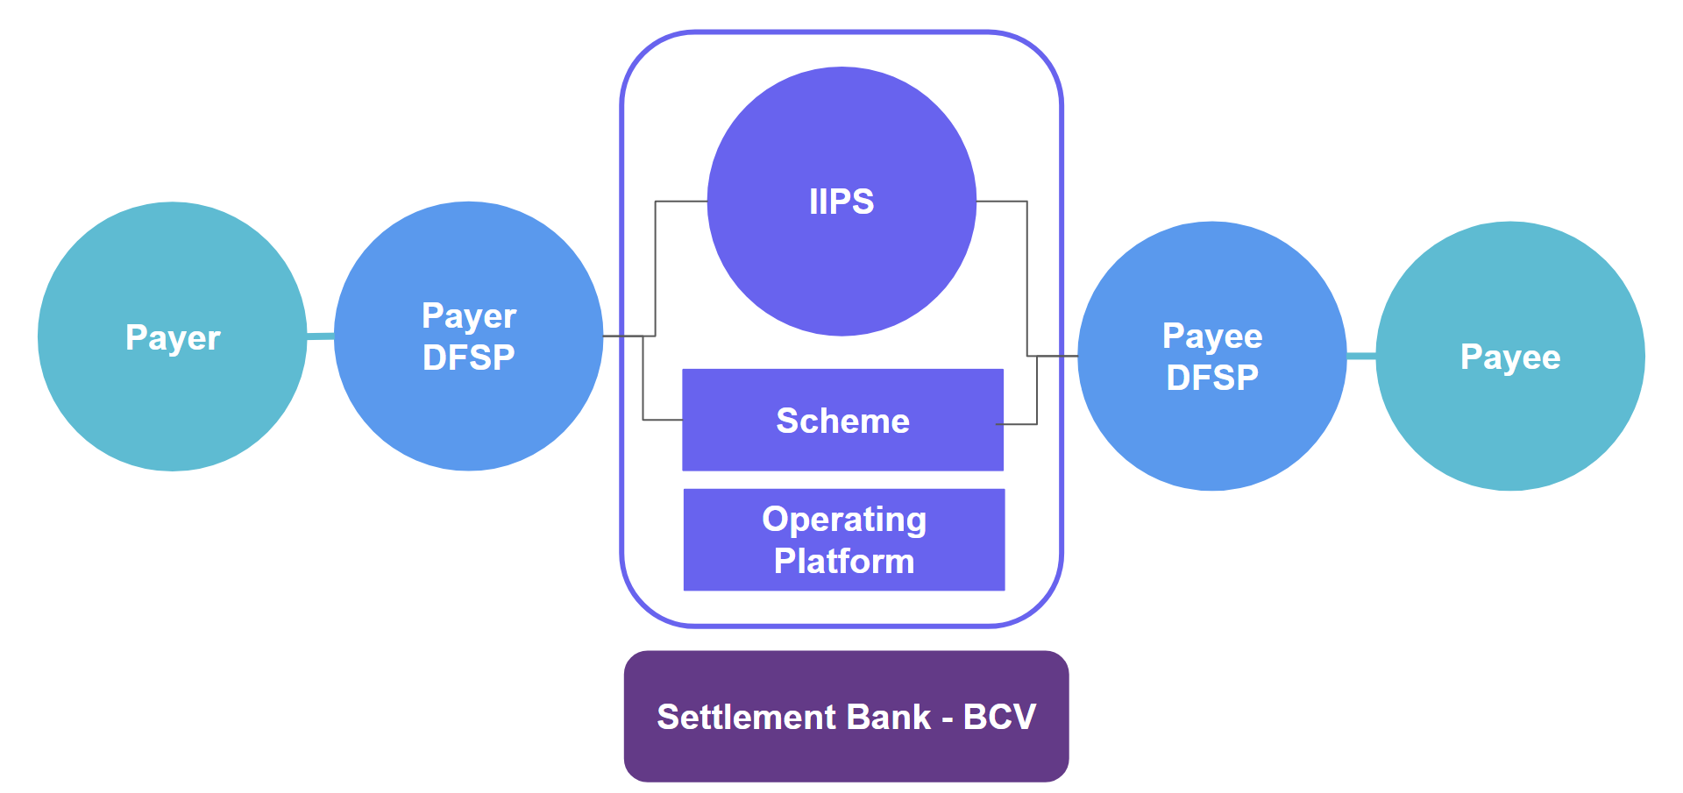
Technical Design: IIPS Overview

Slide 8
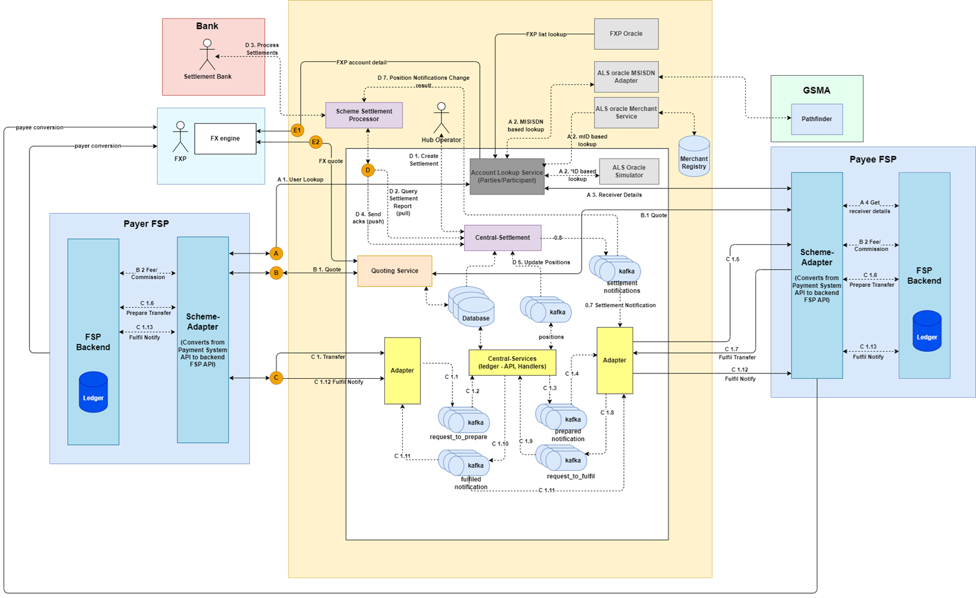
System Architecture Overview

Slide 9

Pilot Outcomes
Mojaloop hub and related modules were deployed and three DFSPs were integrated into the Mojaloop hub.
End-to-end transactions for the P2P use case were demonstrated between test end users of the three DFSPs.
Comprehensive technical knowledge and hub operations processes were transferred to the local teams.
Local teams gained adequate knowledge to build a project plan and cost model for the commercialization phase.

Slide 10
Key Success Factors & Lessons Learned
Leadership of BCV was a key role on the pilot project, as it takes clear ownership of the project and defined the main goals to be achieved with the project.
Engaging stakeholders from the beginning ensures better alignment and understanding of project objectives.
The technical assistance mission, held in-person in Cabo Verde, played a crucial role in achieving significant milestones, such as accelerating the integration process.
Documenting the pilot process and lessons learned ensures stakeholders can effectively use the experience to guide future phases, avoiding repeated issues.
Allocating more time for technical discussions and conclusion of some documents and subjects ensures readiness for upcoming phases.

Slide 11

Next Steps
Discussions with local teams for the commercialization phase
Preparation for the regulatory approval to proceed
Refinement of policies and operational guidelines
Technical and infrastructure scaling

Slide 12
Thank you

